Slide 1
Funding Friday From Idea to Award: How to Craft a Standout Funding Proposal
Friday 17th April 2026
Adam Forristal Golberg
Strategic Research Development Manager (Research Growth) University of Nottingham
adam.golberg@nottingham.ac.uk Bluesky : @Cash4Questions
Blog: www.socialscienceresearchfunding.co.uk

Slide 2

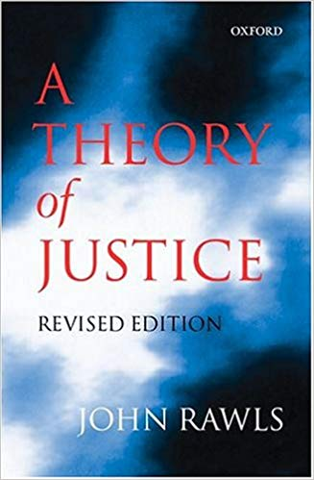


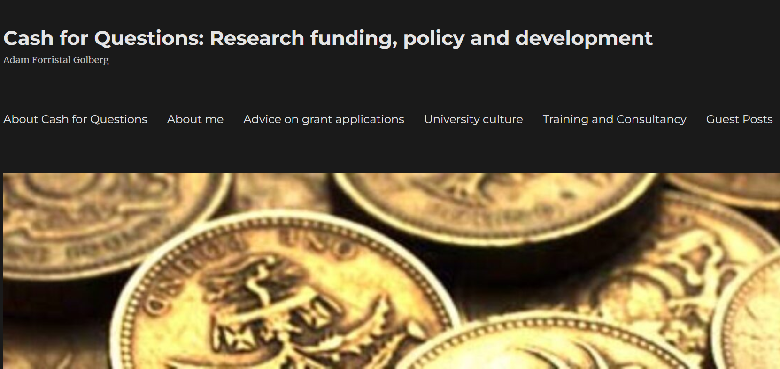

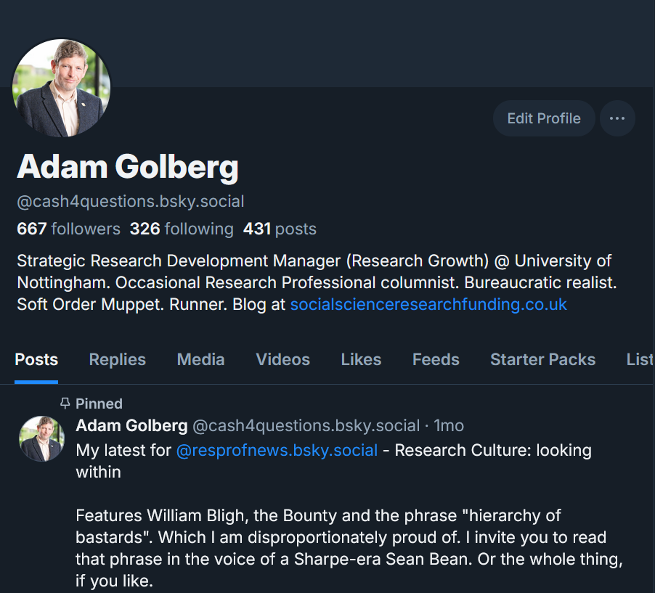


Notes:
This is a personal perspective

Slide 4

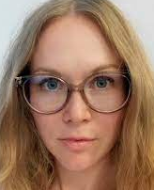
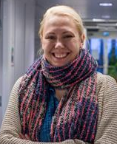
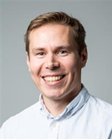
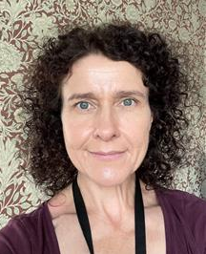
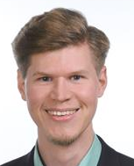
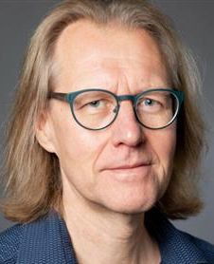
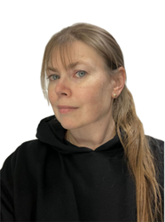
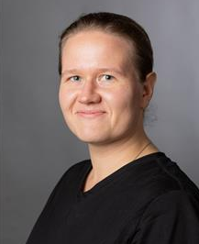
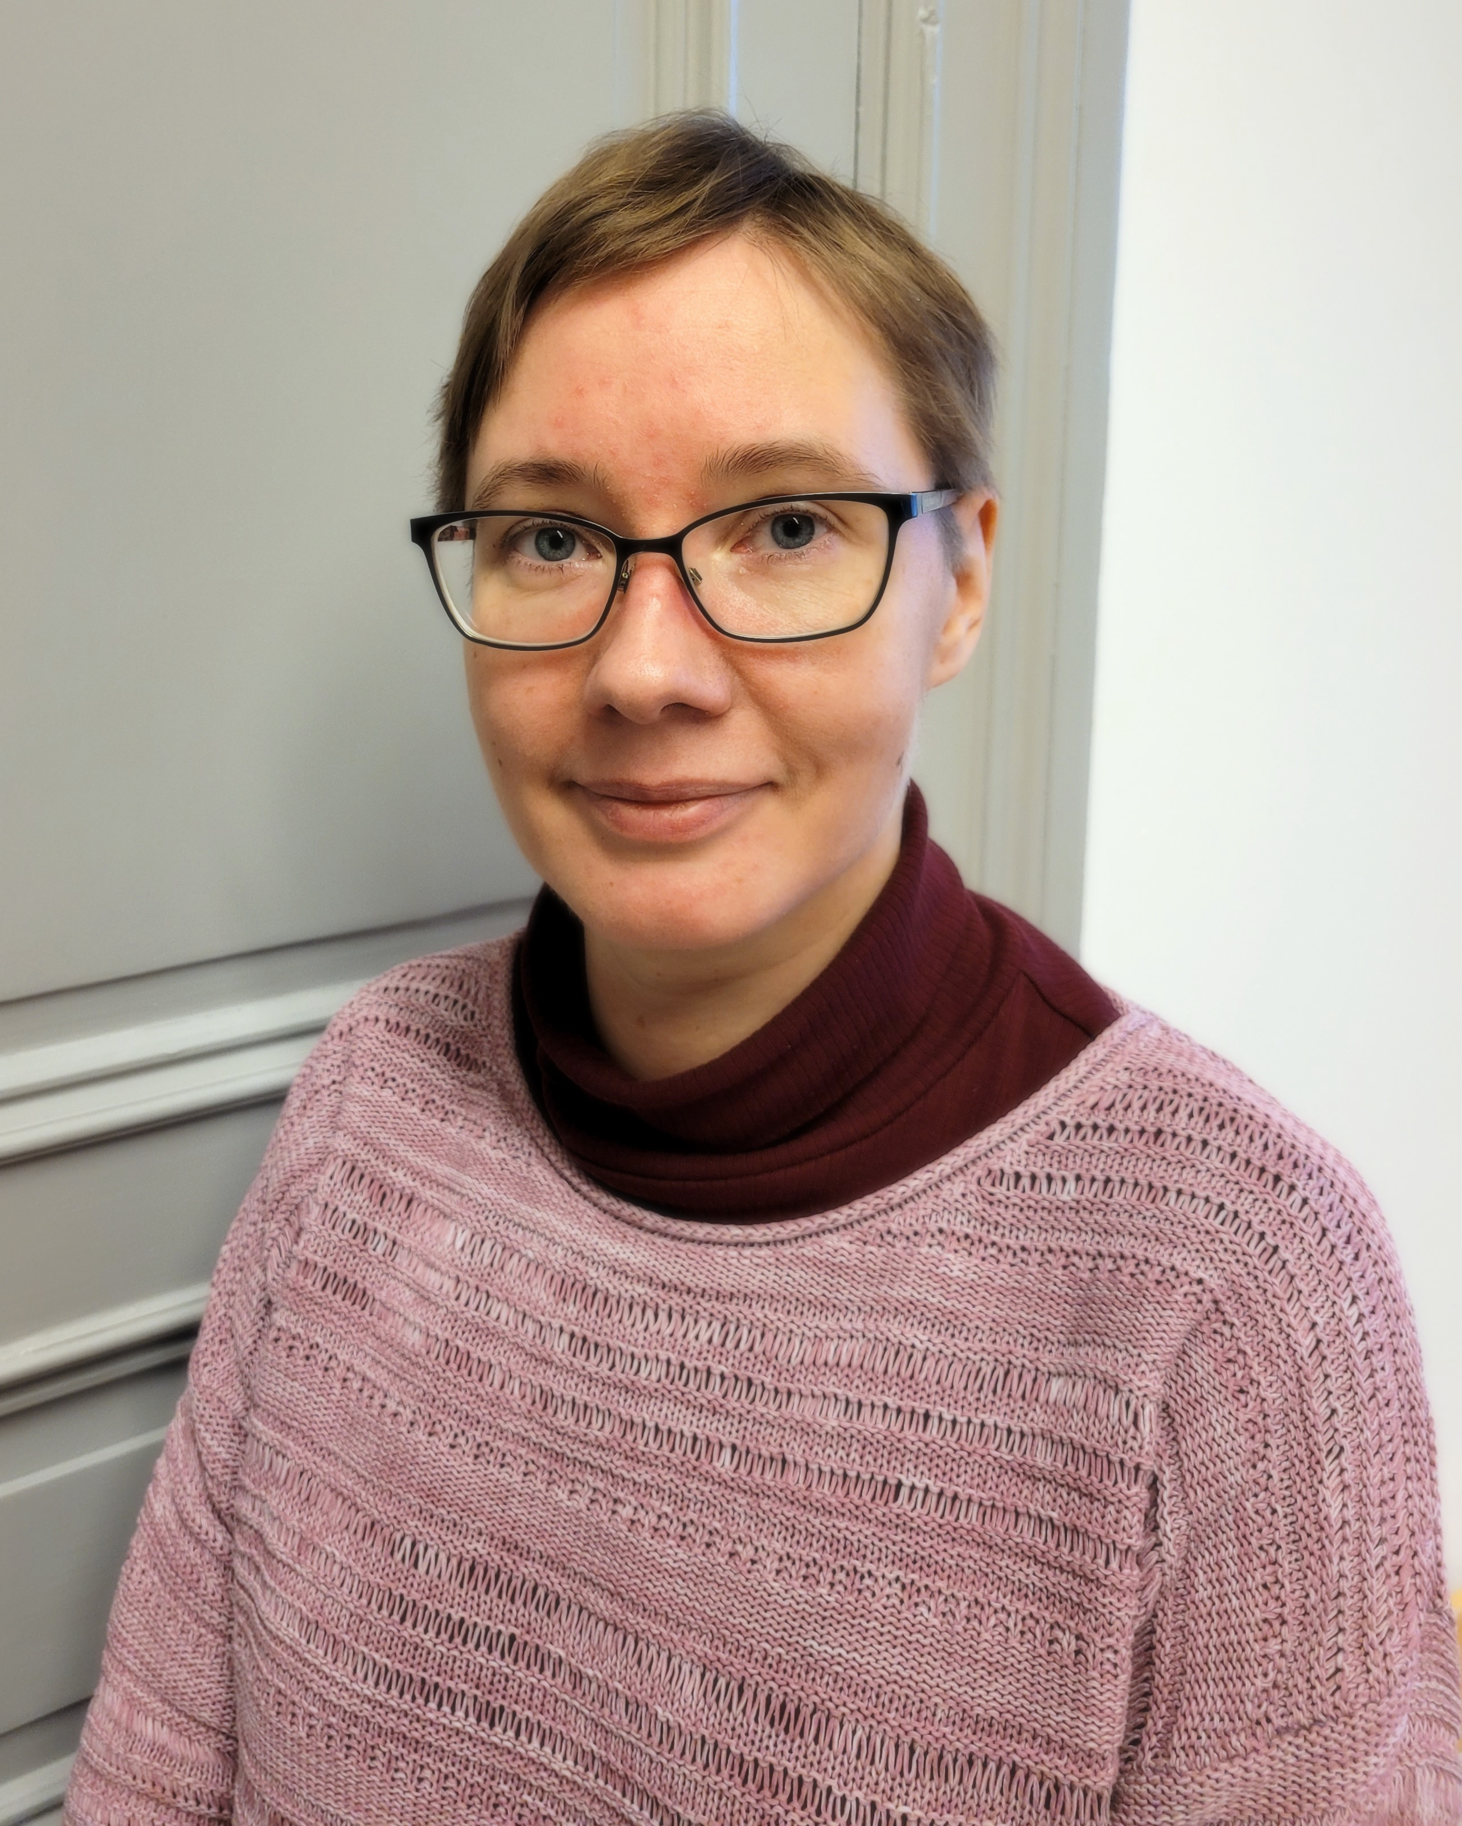
Research Services - Research Funding
Pre-award team
Faculties of Science & Technology + ESO Centre
Visiting address: Signum
Faculty of Medicine, PET Centre & Turku Bioscience
Visiting address: Medisiina C7
Faculties of Humanities, Social Sciences, Law, Education, Turku School of Economics
Visiting address: Signum
Suvi Hentilä
[Team leader]
Maria Maunula [Team leader]
Lauri Keskinen
[Team leader]
Kirsi
Kanerva
Hannu
Hotti
Reima
Helminen
Marika
Karikoski
Tiia
Forsström
TBA
Auli
Bläuer
E-mail: tutkimuspalvelut@utu.fi /researchservices@utu.fi
For InFlames also Jarkko Koivunen and Joe Hettinger

Slide 5
Pre-award services for application phase
We offer support for a variety of funding applications for UTU researchers after completion of PHD, including:​​​
EU funding, predominantly Horizon Europe
Research Council of Finland funding opportunities including Strategic Research Council funding.
International and national foundations
International Educational Cooperation and Funding Opportunities
All other international funding
For any inquiries, refer to our contact details below or email researchservices@utu.fi.
Please note, support for Business Finland funding is supported by Innovation Services. Contact them at businesscol@utu.fi.​

Slide 6
From Idea to Award: How to Craft a Standout Funding Proposal
Everything I know about grant writing, stuffed into a single presentation. Much of which you’ve heard before, possibly from me.
Some very specific thoughts about grant writing
Some thoughts about interdisciplinary research

Slide 7
From Idea to Award: How to Craft a Standout Funding Proposal
How funding decisions really get made and why that matters
The Significance of Significance
Degrees of Detail
Promoting without Boasting
Interdisciplinary Research
Why it’s hard, and why we should bother
How to do more/better
Extra grant-writing challenges for IDR

Slide 8

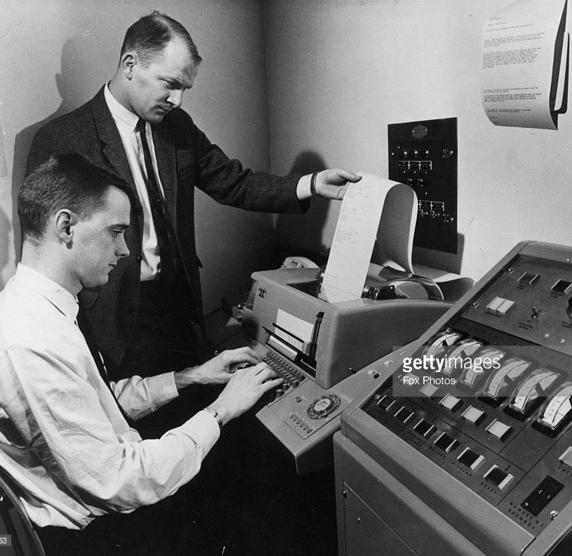
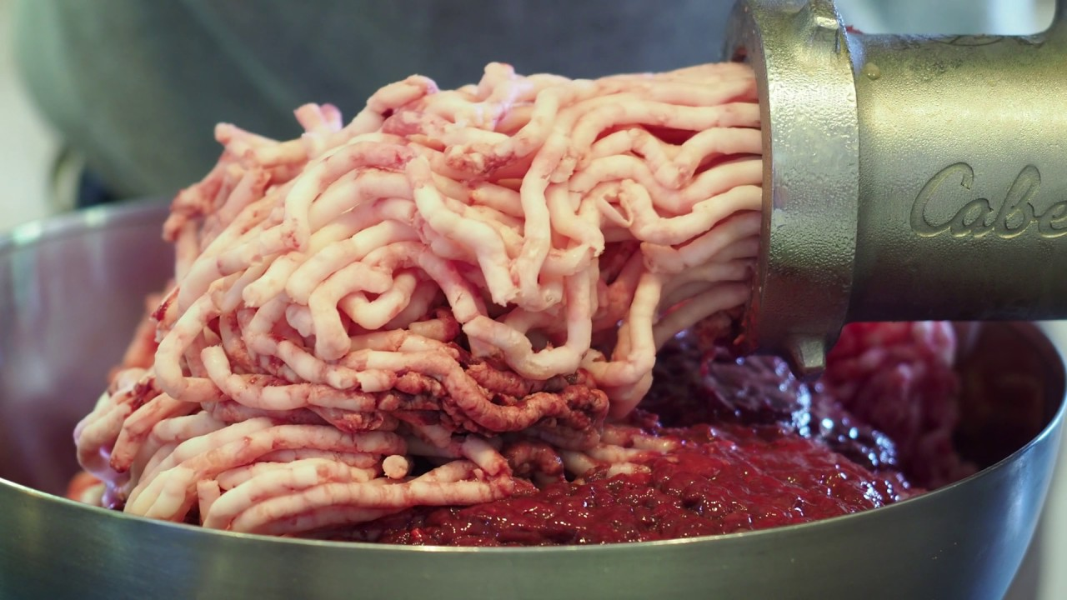
1. How funding decisions get made, and why that matters

Slide 9

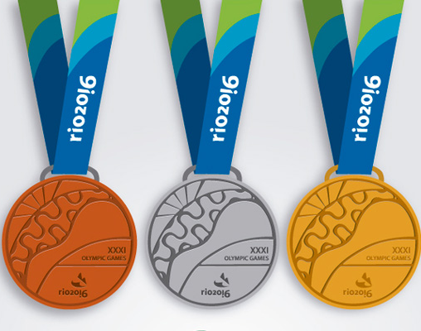
“It’s not a test, it’s a contest” - (attributed to a Canadian Research Council Director)

Slide 10
Understanding the selection process
Desk eligibility check
Sent to expert reviewers
Response to reviews?
Competitive applications/reviews sent to decision making panel members, including one or more ‘introducers’
Ranking/voting or consensus decision making
Discussion/decisions made surprisingly quickly

Slide 11
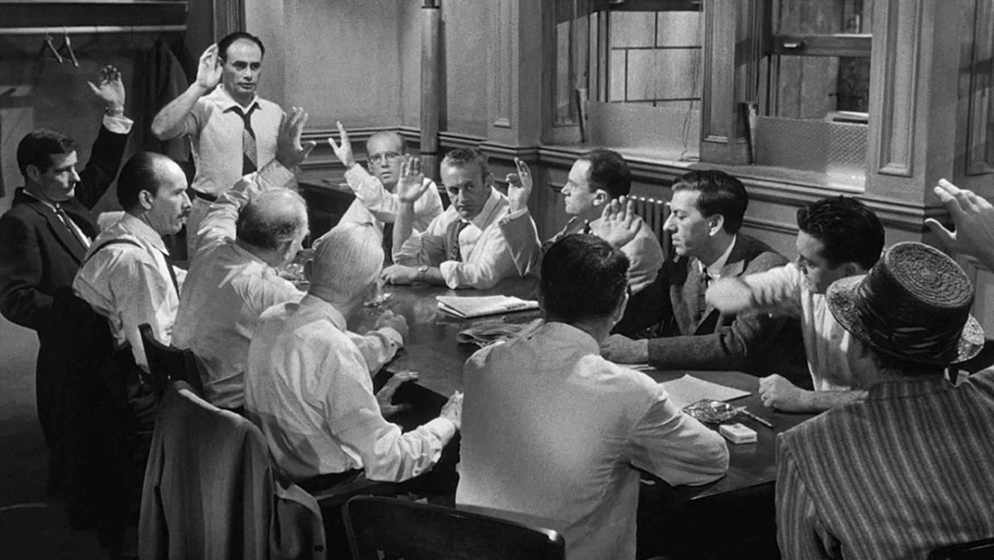

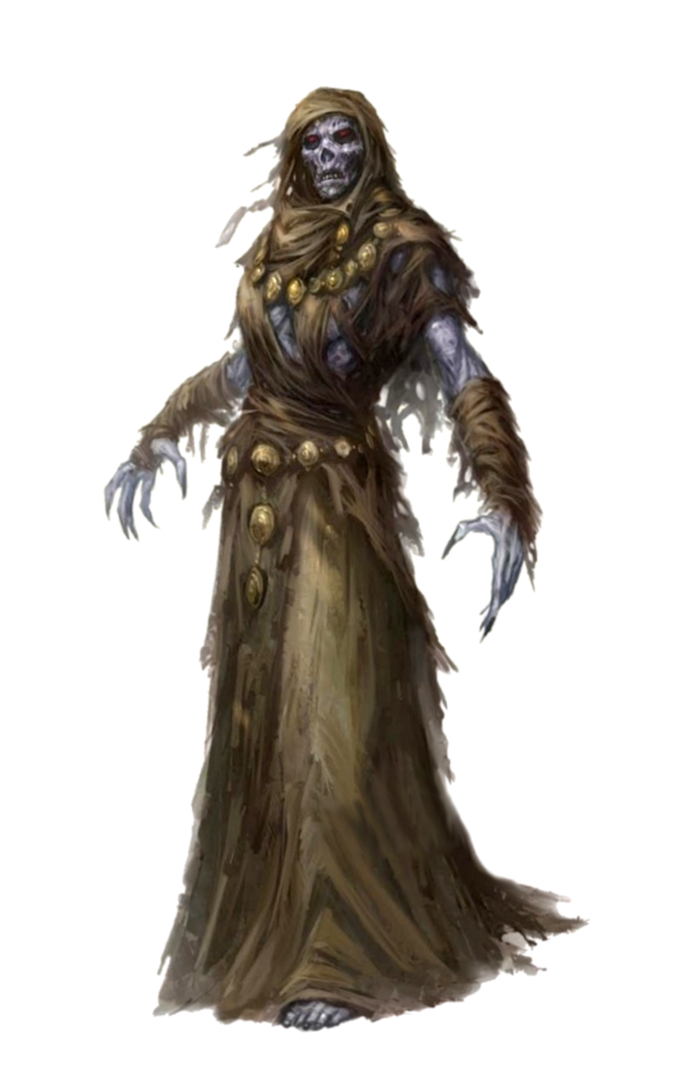
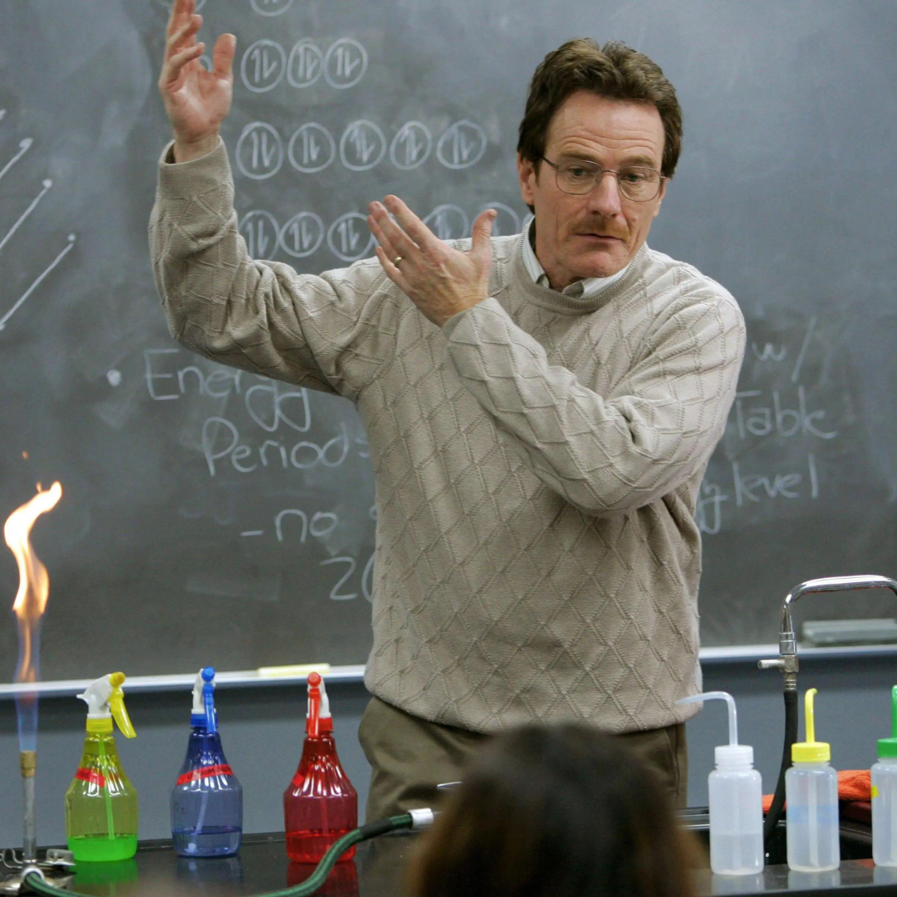
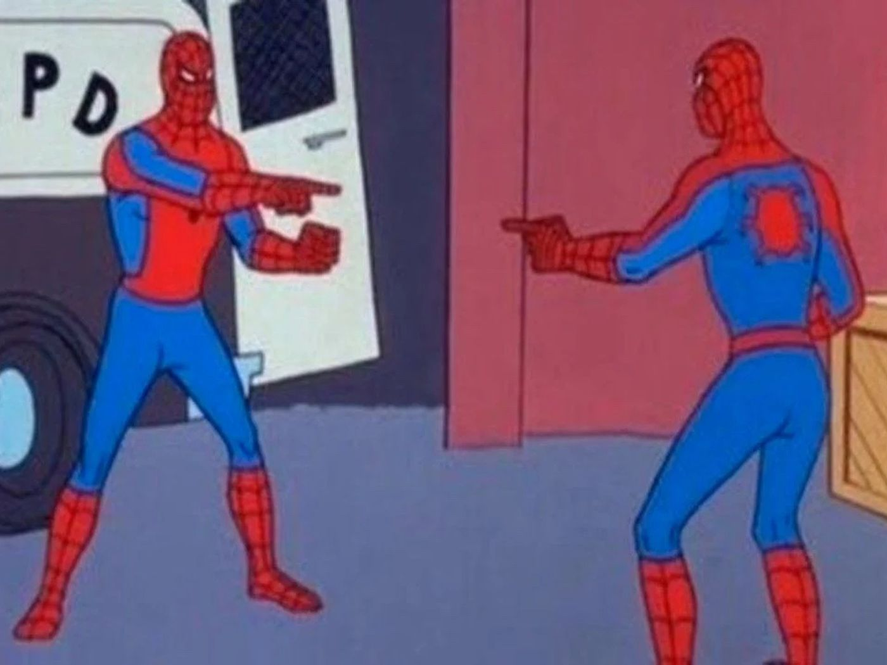
Writing for the right audience: Who are you writing for? Who are you not writing for?

Slide 12
What is a research grant application?
Not like writing an academic paper
Not like fiction – spoil away, no surprises
Bit like journalism - Who? What? When? Where? Why? How?
Bit like an academic sales prospectus
Written for expert and non-expert audiences
A response to a call for applications

Slide 13

Summaries and Titles are vital
What is a summary?
A summary is not an introduction
A summary is not a movie trailer: include everything
A summary should be written in plain language
What is a summary used for?
Helps the reader navigate your proposal, sets expectations
Helps the funding panel recall your application
Can be used to publicise the project later
When to write a summary and the title
Sketch out at the beginning, check in while writing, revise at the end

Slide 14

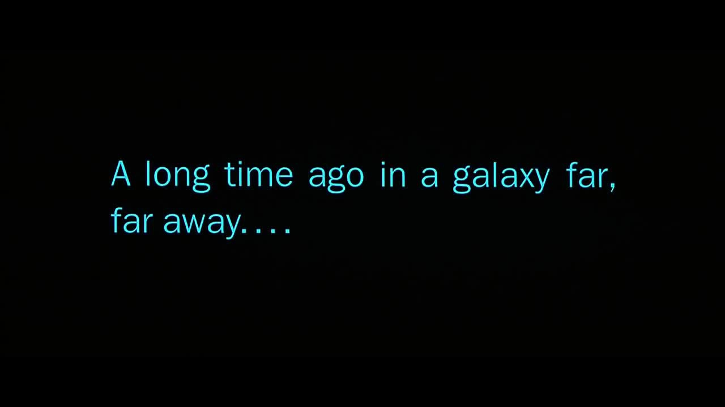
The single most common mistake made by researchers new to grant writing…..
Notes:
The ‘Star Wars’ error in grant writing is a tendency to begin every bid with “A long time ago” and write far too much background and introduction and nowhere near enough about the proposed project.

Slide 15
2. The significance of significance: the “so what? who cares?” factor. Why do this research?
Significance is (nearly) always the key factor
Significance can be academic, real world impact, or both
Can your idea can compete on significance?
Find evidence for significance of problem, and ability of project to address it
Be explicit, don’t leave it to the reviewers to work it out
What will the world look like afterwards?
Standing on the shoulders of giants

Slide 16

What factors (except £) determine your choice when buying a phone or other bit of tech?

Slide 17
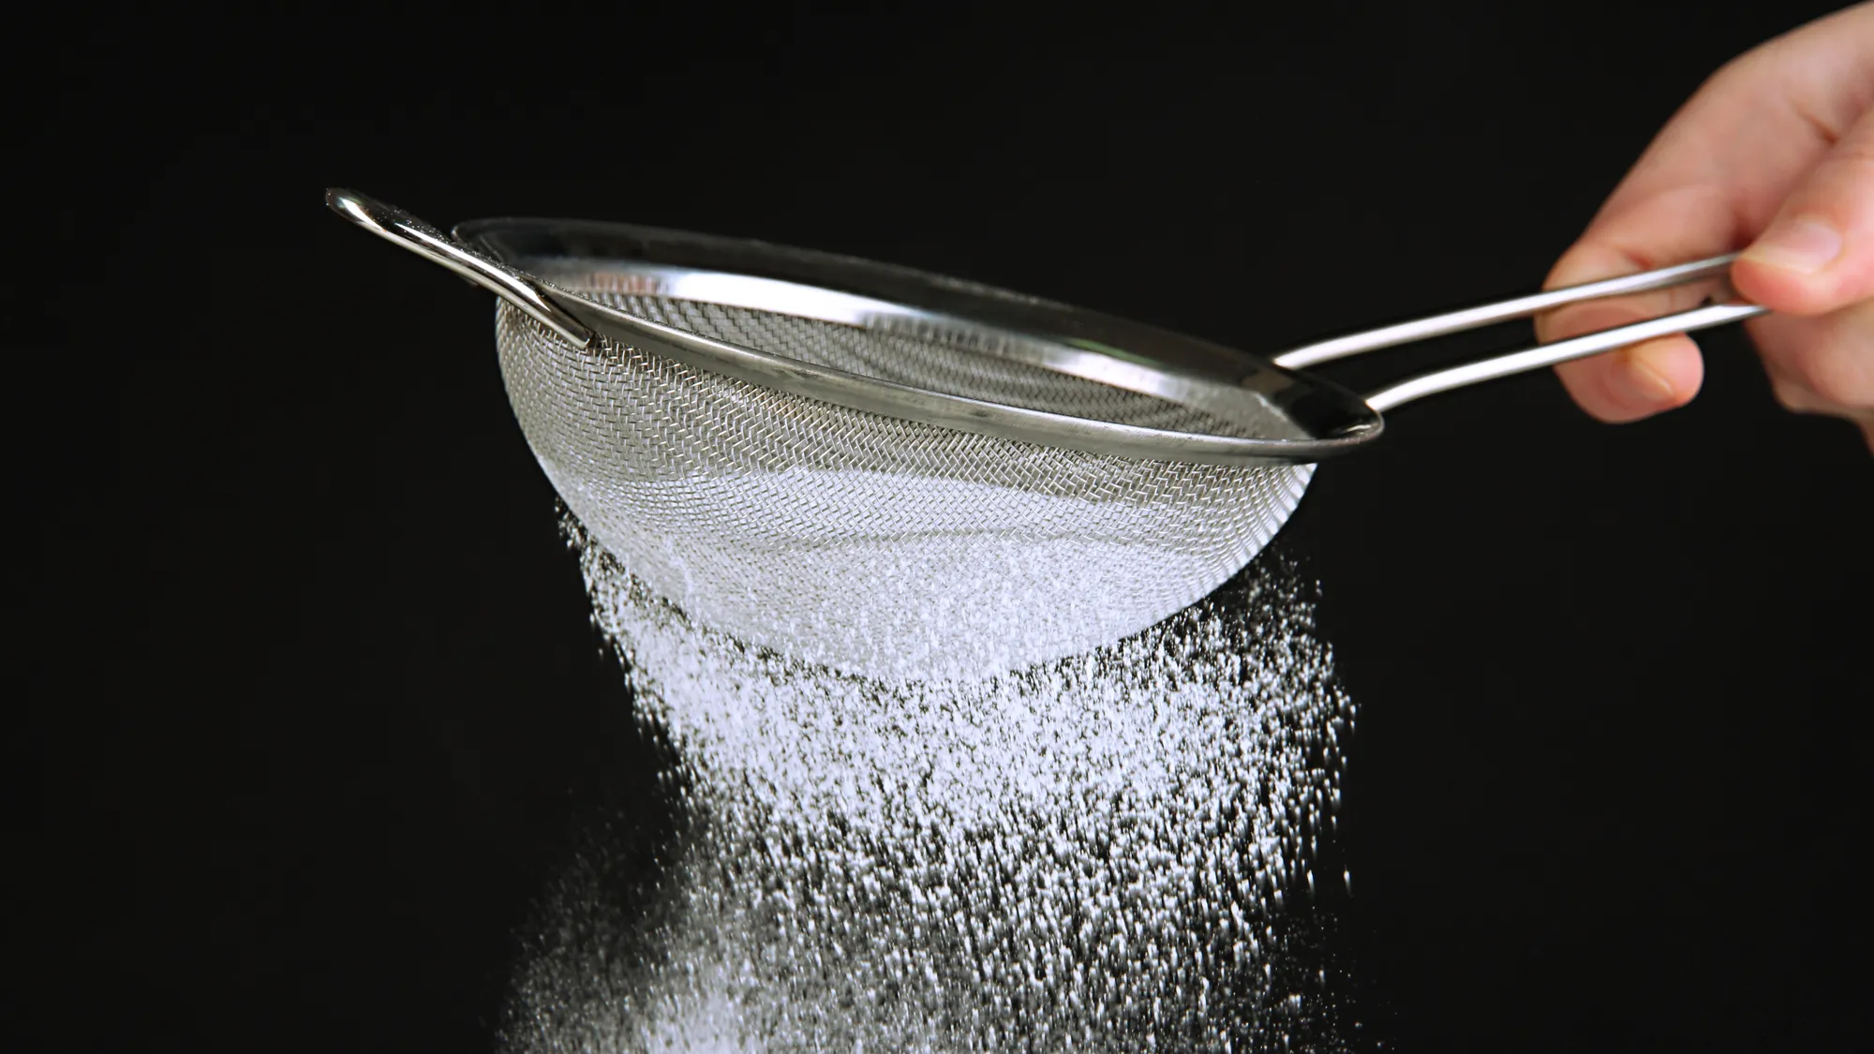

3. Degrees of Detail
The second most common mistake… writing at the wrong level of detail….

Slide 18

(For completeness)
The most serious mistake I see in research grant writing….
Notes:
The ‘Gollum’ error in grant writing is keeping your idea to yourself (“my precioussssss”) and not seeking external feedback.

Slide 19
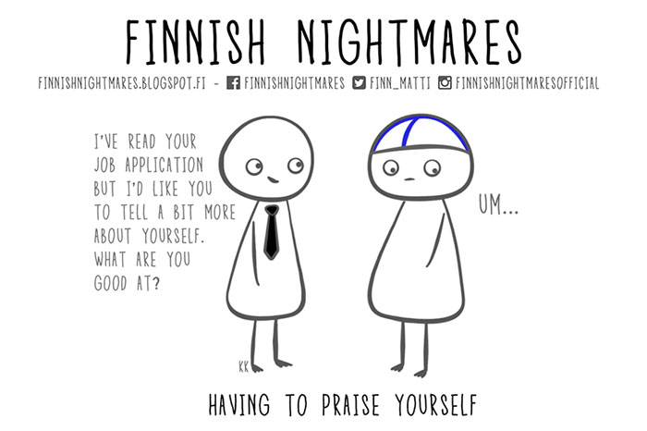
4. Promoting without boasting

Slide 20
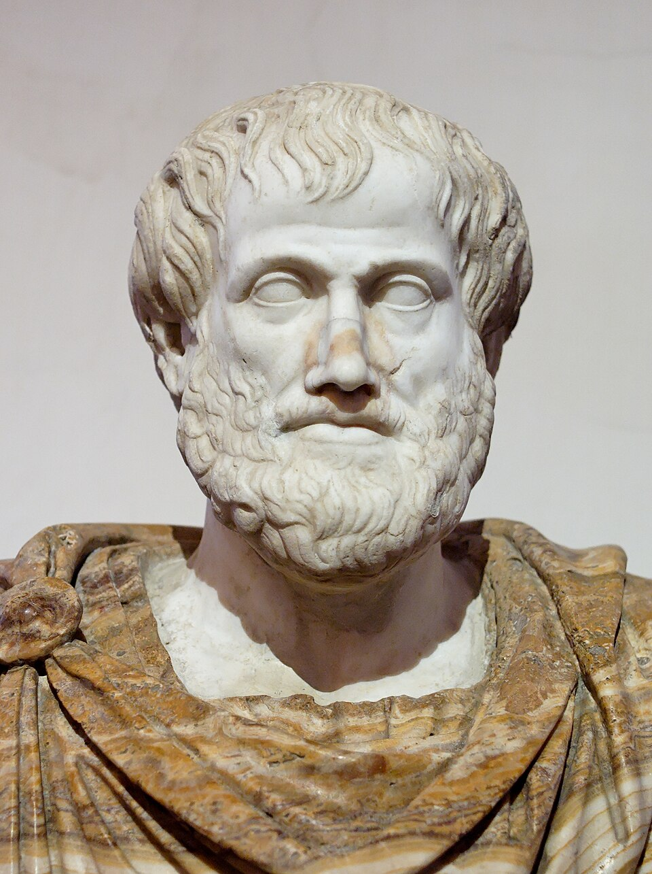
Aristotle and the Golden Mean
Modesty as a virtue
Family, friends, colleagues who know your many virtues
Modesty as a vice
Strangers who do not
By After Lysippos - Jastrow (2006), Public Domain, https://commons.wikimedia.org/w/index.php?curid=1359807

Slide 21
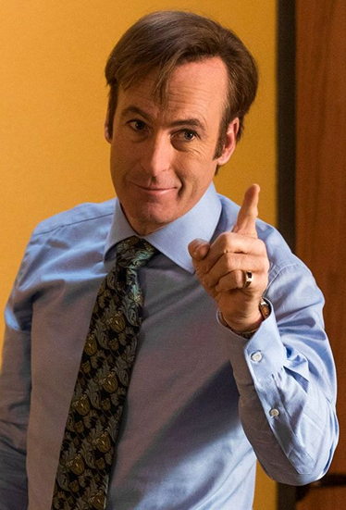
Practical suggestions
Excessive modesty is an offence against truth.. and science
Show, don’t tell – details and argument
Tell them why you’re telling them what you’re telling them
Don’t “Trump”
Avoid generic cut and paste text
Channel your inner lawyer
“… is designed to…”
Because of the Dunning-Kruger effect, get other people’s help

Slide 22
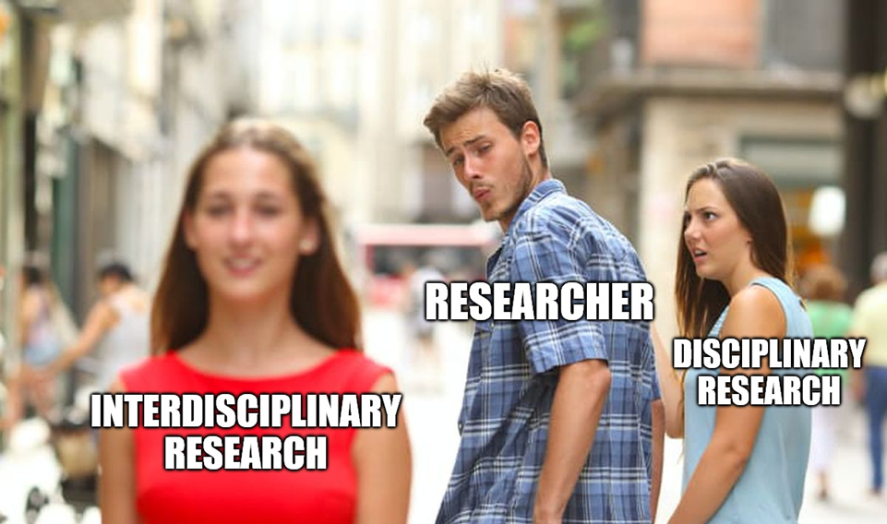
1. Interdisciplinary Research

Slide 23
Interdisciplinary Terminology
Cross-disciplinarity
Inter-disciplinarity
Multi-disciplinarity
Trans-disciplinarity

Slide 24
Interdisciplinary Terminology
Cross-disciplinarity
Inter-disciplinarity
Multi-disciplinarity
Trans-disciplinarity

Slide 25
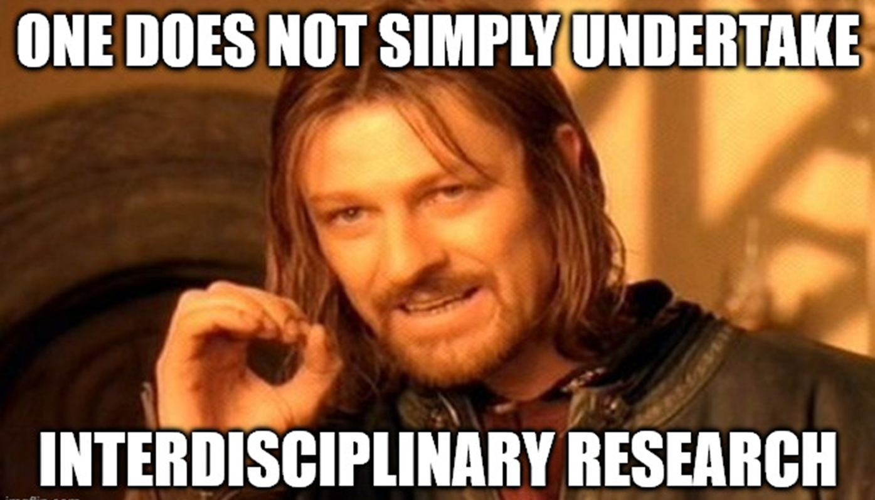
2. Interdisciplinary Research is Hard

Slide 26

Why is Interdisciplinary research hard?
Academia is arranged into disciplines with their own gravitational pull
Shared and agreed methods
Common language, training, curriculum, and assumptions
Mechanisms of status, support, and reward
Organisational arrangements (universities and funders)
Gatekeeping
Working across disciplines - learning a new language. Knowing what questions to ask, and how to understand the answers

Slide 27
Why is Interdisciplinary research hard?
Stars need to align: overlap of interest; a common problem, compatible motivations and priorities; aligned incentives, resources (time/££), personal chemistry.
Requires up front investment/ commitment with no guaranteed return
… because monodisciplinary research is easier, quicker, less painful, more immediately productive, and still makes a huge contribution to knowledge.

Slide 28

Given that it’s hard, why are we bothering?
Six (or four) magic words….

Slide 29
Given that it’s hard, why are we bothering?
Six (or four) magic words….
What are we trying to achieve?
Mitä me yritämme saavuttaa?
Is it an end in itself, or a means to an end? What are those ends?

Slide 30
Given that it’s hard, why are we bothering?
Pace of scientific discovery is slowing down
Advances in one field creates opportunities in others
Novel Methods meets Novel Use case = everyone gets a paper
The only way to address real world challenges / wicked problems
To access genuinely interdisciplinary funding
To access larger funding pots in other disciplines
Because university management wants us to

Slide 31
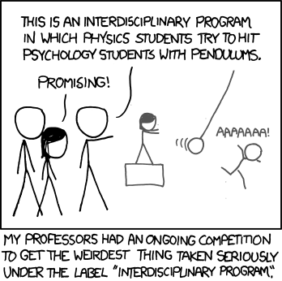
Ways it can fail or under-deliver
The Marriage of Convenience
“Hitting psychology students with pendulums”
What interests us > what we’re experts in
The Empty Middle
“Country and Western”
XKCD ‘Interdisciplinary’ https://xkcd.com/755/

Slide 32
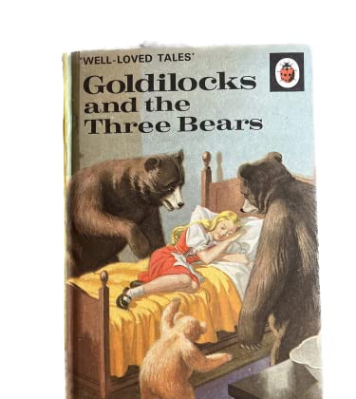
3. How do we do more/better?
Lower your expectations
Use institutional mechanisms
Look out for events or suggest some
Talk to colleagues already working in/with target discipline
Don’t limit yourself to your own institution
Don’t ask, don’t get
Don’t instrumentalise other researchers…
… have some idea what you want to achieve
Hone your pitch
Be comfortable with your ignorance

Slide 33
Should I get more involved in interdisciplinary research?
Would you like to? How would that feel? What would it look like?
What do you need?
What could you contribute?
Some expertise lends itself to IDR more than others
Some topics/disciplines more suitable – inherent in some, unusual in others
Some people are better communicators
Six Magic Words

Slide 34
4. Special considerations with interdisciplinary research applications
Everything I’ve already said, but more so…
Who are you writing for?
Difficulty in finding reviewers
The Significance of Significance
What does it do? -> How does it work?
Locating and stressing the novelty/contribution
Degrees of Detail
Promoting without Boasting
Also
Appropriate funders/schemes

Slide 35
Further reading:
Everything I’ve written on grant-getting
http://socialscienceresearchfunding.co.uk/?cat=16
Follow me on Bluesky @cash4questions
https://www.linkedin.com/in/adamgolberg/
Funding Insight
https://www.researchprofessionalnews.com/category/world/world-funding-insight/
David Karlin https://moretime4research.com/
Research Whisperers https://researchwhisperer.org/

Slide 36
TL:DR
If you remember nothing else that I’ve said…
… remember not to be Gollum.
Questions?
Notes:
The ‘Gollum’ error in grant writing is keeping your idea to yourself (“my precioussssss”) and not seeking external feedback.

